Slide 1
Our health
13. Present perfect and past simple

Slide 2
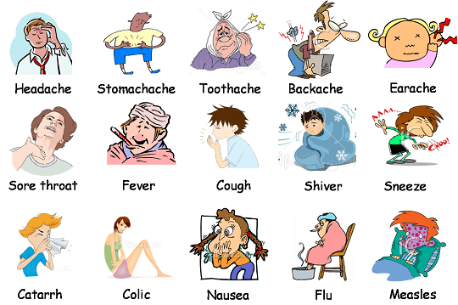
In sickness and health
When was the last time you got sick?
What happened?
When was the last time you went to a hospital?
How often do you get sick?
Notes:
Measles – sarampión

Slide 3
Present Perfect Simple
We use the Present Perfect Simple to talk about actions that began in the past and are still continuing in the present, or actions which were completed in the past, but are still connected to the present.
We also use the Present Perfect Simple when the exact time of the action is unknown or unimportant.
(+) Subject + have/has + past participle = I have taken all my pills.
(-) Subject + have not / has not + past participle = He hasn’t written the prescription.
(?) Have / Has + subject + past participle = Have you read the report?
We can use the following time expressions:
For, since, ever, never, yet, already, lately, recently, just.
Notes:
Grammar practice: start at 4:07 https://www.youtube.com/watch?v=553eeL1Dvho

Slide 4
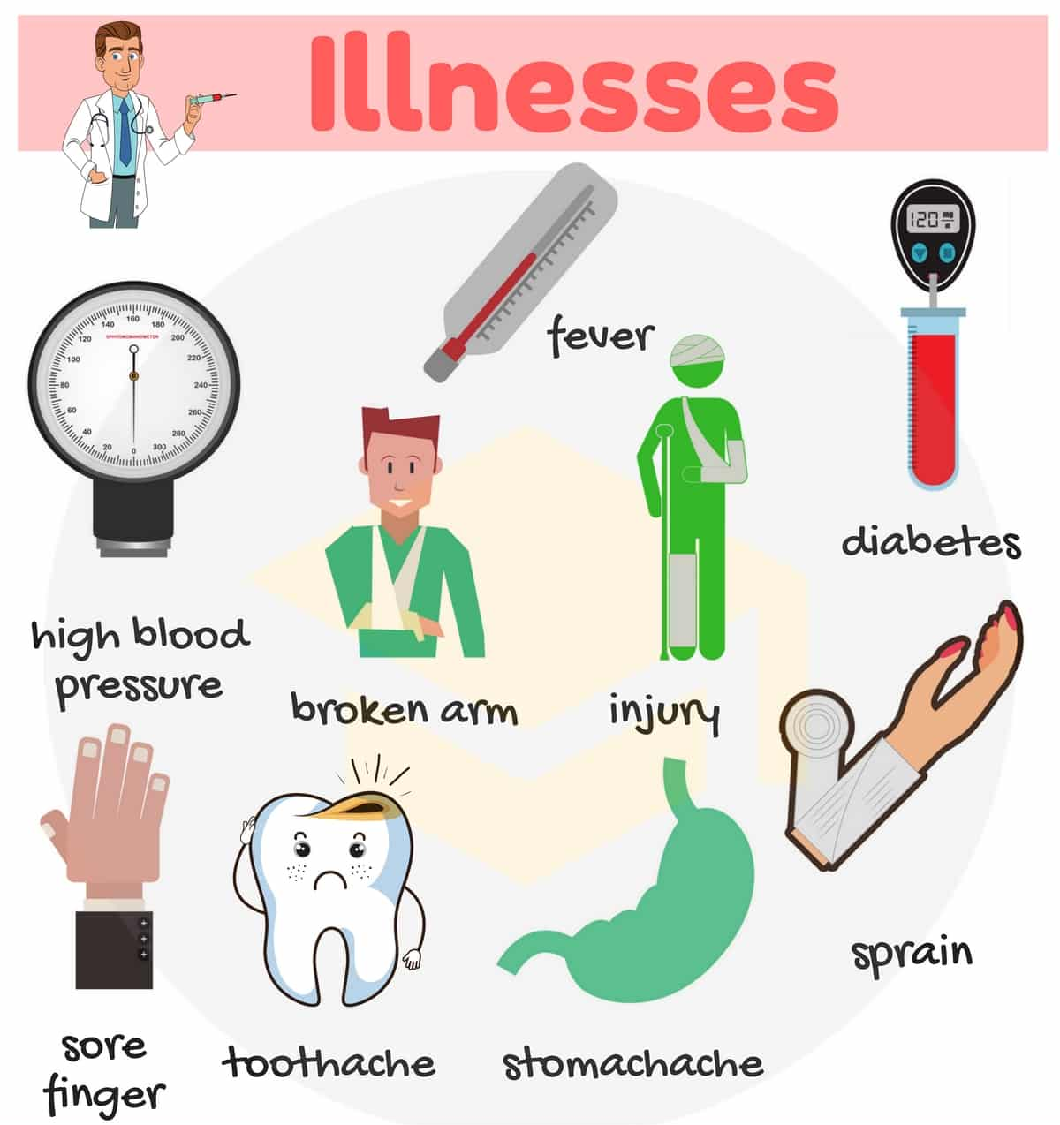
Complete the sentences
______ (drink) enough fluids today?
The doctor ______(not tell) me the results of my blood test.
______ the nurse ______(take) your blood pressure?
How many antihistamine pills ______ you ______(take) since last night?
The children ______(rest) for a few days. Now they can go back to school.
Jerry ______(not be) for his routine checkup yet.
My husband ______(catch) the flu. He’s resting in bed right now.
I ______(just / take) my son’s temperature. He has a low fever.
Samantha is allergic to many things. She ______(suffer) from allergies since she was a child.
I ______(have) a bad headache for a few days, but I ______(not see) the doctor yet.
Notes:
Sprain - esguince
1. Have you drunk
2. hasn’t told
3. Has … taken
4. have … taken
5. have rested
6. hasn’t been
7. has caught
8. have just taken
9. has suffered
10. have had, haven’t seen

Slide 5
Past Simple and Present Perfect Simple
We use the Past Simple to talk about actions that happened at a specific time in the past, actions that began and ended in the past, and describe a series of events that happened in the past.
We can use the following time expressions with the Past Simple:
Yesterday, last week, two days ago, in 2007, on Monday (= last Monday).
We use the Present Perfect Simple to talk about actions that took place sometime in the past, when the specific time is not mentioned, actions that began in the past and continue in the present, and actions that happened in the past, but still influence the present.
We can use the following time expressions with the Present Perfect Simple:
For, since, ever, never, yet, already, lately, recently, just.

Slide 6
Past simple or present perfect?
I ______ (not go) to the hospital yet.
My grandmother _____ (pass away) 10 years ago.
____ you ever ____ (have) a cast?
I ____ (break) my arm last year. I ____ (be) so scared because I saw my bone.
He ____ (see) a car crash last week, but we _____ never ___ (see) one.
They ____ (travel) without insurance before 2022.
You _____ (not eat) lactose for 2 years to avoid any accidents.
We ____ (be) in the emergency waiting room since 7 am.
I ____(be) careless when I drive. Once I even _____ (crash) my car.
When he ___ (be) a child his mom ____(teach) him to put on his seatbelt always.
Notes:
Have not gone
Passed away
Have, had
Broke, was
Saw, have seen
Travelled
Have not eaten
Have been
Have been, crashed
Was, taught

Slide 7
Time expressions and position
Time Expressions | Position
Already, recently, lately | Usually come at the end of a sentence. Can also be placed between has / have and the past participle.
Ever, never, just | Come between has / have and the past participle.
Often, ever, yet | Often is used for questions. Ever comes after the subject. Yet comes at the end of a question, and it is often used in negative sentences.
since … , for … | Come at the end of a sentence.
… ago, last … , yesterday | Come at the beginning or end of a sentence.
Notes:
Check the video on usage. Start at 6:34 – 10:47
Start at 11:37
https://www.youtube.com/watch?v=H0nMCC0TS-E

Slide 8
Complete the sentence with a suitable time expression
Last week • six weeks ago • since • How long • already • Yesterday • just • When • never • for
The nurse has _____ put a bandage on the boy’s ankle.
_____ has Simon had the cast on his arm?
_____ did the nurse give the patient the injection?
The ambulance has _____ arrived. They are helping the injured man.
Mary has had stitches in her arm _____ her accident.
Peter had a bad accident _____. He was hospitalized for a few weeks, but now he is all right.
I have an infection in this wound and a high fever. I have _____ felt so awful in my life!
_____ Peter fell off his bike and sprained his ankle. Now he has a bandage on his ankle.
_____ Larry went to the emergency room because he had an arm injury. This week he went again because he sprained his ankle!
Tom’s arm has been in a cast _____ a month. The doctor will only take it off in two weeks’ time.
Notes:
1. already / just
2. How long
3. When
4. just / already
5. since
6. six weeks ago
7. never
8. Yesterday
9. Last week
10. for

Slide 9
Two truths and one lie
Write three sentences about your life.
Two must be true and one must be a lie.
Tell your friends your 3 sentences.
They have to guess which one is a lie.
Example:
I have never had surgery.
I have never scuba dived.
I have never had chicken pox.
Notes:
I have had chicken pox.

